Slide 1
Csc4006: Advisory session how to formulate a research QUESTION and do a literature review?
Dr Blesson Varghese
b.varghese@qub.ac.uk; www.blessonv.com

Slide 2
acknowledgement
On research question:
https://writingcenter.gmu.edu/guides/how-to-write-a-research-question
On literature review:
https://www.rlf.org.uk/resources/what-is-a-literature-review/
https://www2.le.ac.uk/offices/ld/resources/writing/writing-resources/literature-review
https://phdlife.warwick.ac.uk/2014/01/04/writing-a-literature-review/

Slide 3
What is a research QUESTION?
A research question is a...
clear
focused
concise
complex
arguable
...question around which you centre your research.
The question should keep you interested at least until you complete the research.

Slide 4


Why is a research question essential?
Provides focus for the research done
Provides a path for the research (technical and writing process)

Slide 5



Steps to develop a research question
Step 1: Choose an interesting general topic
Step 2: Start reading articles on the area
Identify gaps in state-of-the-art
Contributes to
a literature review

Slide 6




Steps to develop a research question
Step 3: Start asking questions around identified gaps?
Ask more questions!
Step 4: Shortlist / choose questions
Based on the challenge
Based on your interest
Based on reward
Based on an estimation of effort required
Step 5: You will need to read more to bring clarity and focus to your question
This is the point where a Literature Review is done

Slide 7
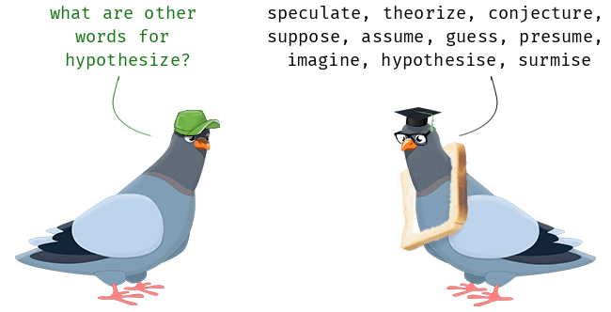

Steps to develop a research question
Step 6: Evaluate your question
Is it clear?
Is it focused?
Is it doable?
Step 7: Hypothesize
What path you think the answer will take
Where do you think your research will take you
What kind of argument are you hoping to make/support

Slide 8
Steps to develop a research question
Unfocused vs Focused
Example 1:
Why are social networking sites harmful?
How are online users experiencing or addressing privacy issues on such social networking sites as MySpace and Facebook?
Example 2:
What is the effect on the environment from global warming?
How is glacial melting affecting penguins in the Arctic Circle?
A computer science example
How can applications make use of the Cloud?
What scheduling techniques are required for making effective use of the Cloud?
What scheduling techniques are required to ensure fair allocation of resources on the Cloud?
What scheduling techniques are required to ensure fair allocation of resources while maximising the performance of an application on the Cloud?

Slide 9
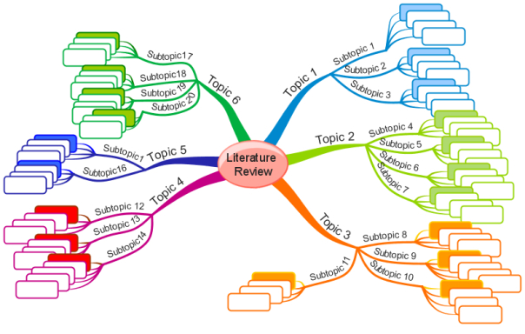
What is a literature review?
A literature review is a search and evaluation of the available literature in your topic area of relevance to the chosen problem.

Slide 10
Why is a literature review essential?
Questions that a literature review should answer:
What research question(s) are you asking?
Why are you asking it/them?
Has anyone else done anything similar?
Is your research relevant to research/practice/theory in your field?
What is already known or understood about this topic?
How might your research add to this understanding, or challenge existing theories and beliefs?

Slide 11
Why is a literature review essential?
Aims to accomplish four tasks:
Demonstrates a familiarity with a body of knowledge and establishes the credibility of your work
Summarises prior research and says how your project is linked to it
Integrates and summarises what is known about a subject
Demonstrates that you have learnt from others and that your research is a starting point for new ideas

Slide 12

tIps to do a literature review
Starting point:
You need to compile a reading list
Work with your supervisor on this
If you haven’t already get to it right away
Search for articles with keywords related to your area, problem etc
IEEExplore, ACM Digital
Google Scholar
Read articles from reputed venues
IEEE, ACM venues are generally good
Check with your supervisor for area-specific advice

Slide 13

tIps to do a literature review
Organise information
Ask what information do I need?
Key theories, methodologies, algorithms used to solve the problem
Keep coming back to your research question and ask:
Why is the article I am reading interesting in light of what I want to do?
Should this be added to my review

Slide 14

Tips to do a literature review
Note taking
When reading an article make notes on:
Identified methods, algorithms, and experiments
Strengths and weakness of the research
Relevance to your problem and project

Slide 15

Tips to do a literature review
Tell a story
Put together a single narrative
Reference existing methods/techniques/algorithms
Highlight their strengths/weakness
Present any gaps
Indicate how your research will address concerns or bridge any gap

Slide 16
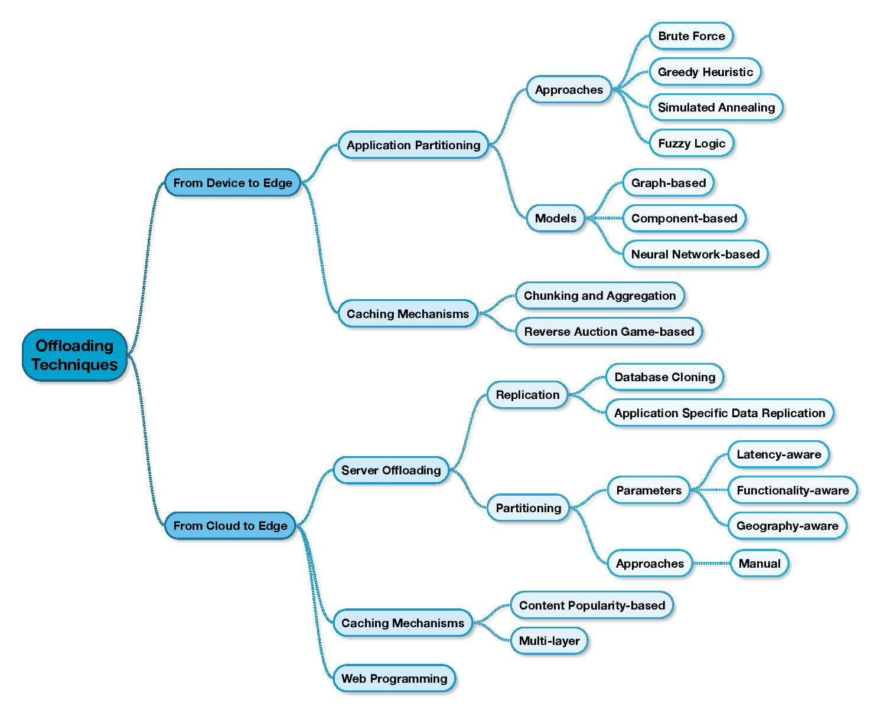
Literature review - example
A literature review in an article that focused on offloading techniques in Cloud-Edge computing
The narrative was based around the diagram
Differentiated my research from the existing methods etc

